Slide 1
Real-Time Facial BMI Detection
Dharmi Gala
Machine Learning & Predictive Analytics
Final Project

Slide 2
Facial Image-Based BMI Prediction
Body Mass Index (BMI) is a widely used indicator of body composition and health.
Traditional BMI assessment methods rely on self-reporting or physical measurements, which can be subjective and time-consuming.
There is a need for a more efficient and accurate approach to estimate BMI using non-invasive techniques.
Our goal is to develop a machine learning solution that predicts BMI based on facial images, providing a convenient and reliable alternative to traditional methods.

Slide 3
Data
1. About Data:
The dataset includes a total of 4,206 faces categorized into different BMI ranges, with 7 faces in the underweight range, 680 faces in the normal range, 1,151 faces in the overweight range, 941 faces in the moderately obese range, 681 faces in the severely obese range, and 746 faces in the very severely obese range.
The dataset consists of 2,438 males and 1,768 females, and a subset of 838 images was designated as the test set, while the remaining images were used for training and evaluation.
During the dataset processing, 158 images were identified as missing from the training set, and 86 images were missing from the test set. These missing images were excluded from the training and evaluation processes to ensure the integrity and consistency of the dataset used for model training and testing.
2. Pre-processing:
Loaded metadata and filtered images from a specified folder.
Pre-processed images using 'preprocess_input' from ResNet50: resizing, conversion to array, and normalization.
Leveraged ResNet50 for optimized pre-processing and compatibility with VGG16.
Applied augmentation techniques using ImageDataGenerator to increase training data diversity.

Slide 4
Models
1. Model 1 (VGG16):
Utilized VGG16 model pre-trained on ImageNet as the base model, excluding the top layers.
Constructed a Sequential model by adding the base model, followed by Flatten, Dense, Dropout, and output layers.
Trained the model with Adam optimizer, mean absolute error loss, and 15 epochs. Evaluated using metrics such as MAE, MSE, R-squared, and correlation coefficient.
2. Model 2 (VGGFace + SVR):
Employed VGGFace variant of VGG16, pre-trained on facial recognition tasks, for feature extraction.
Extracted features using the VGGFace model and applied Global Average Pooling to condense the data.
Utilized Support Vector Regression (SVR) to predict BMI labels based on extracted features. Evaluated using metrics such as MAE, MSE, and Pearson correlation coefficient.

Slide 5
Results & Conclusion
The first model achieved a moderate level of accuracy with a Mean Squared Error (MSE) of 62.65, Mean Absolute Error (MAE) of 5.79, and Correlation Coefficient of 0.52.
The second model outperformed the first model, with a lower Mean Absolute Error (MAE) of 5.30 and a stronger positive linear relationship between the predicted and actual BMI labels, as indicated by the Pearson Correlation Coefficient of 0.64.
These results highlight the significance of incorporating domain-specific pre-trained models and employing appropriate regression techniques, such as Support Vector Regression (SVR), for accurate BMI prediction. The study demonstrates the potential of facial image analysis and machine learning in assessing BMI based on facial images.

Slide 6
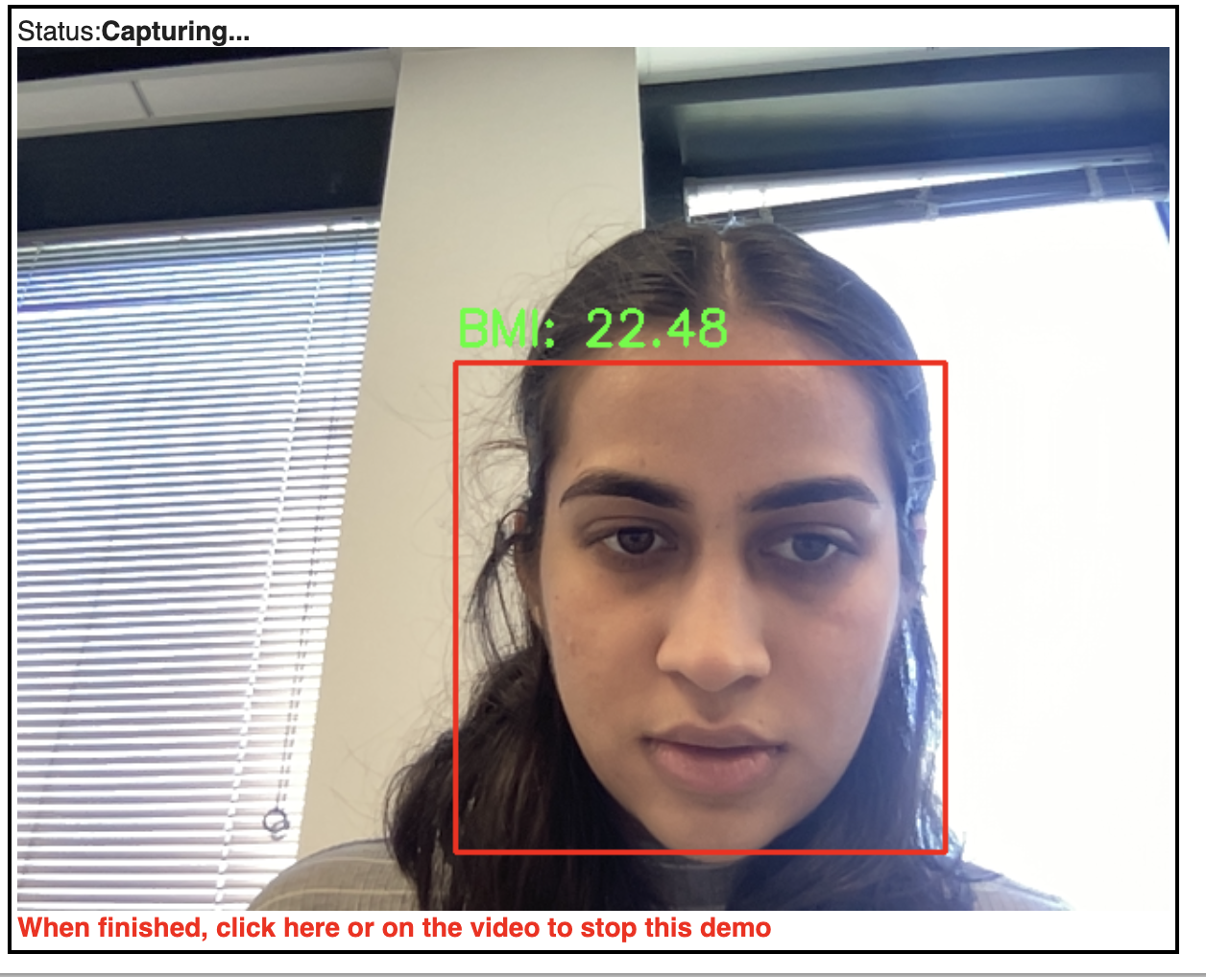
Application
The solution also included usage of webcam input to detect faces in real-time and predict the body mass index (BMI) based on facial images. It utilizes pre-trained models for face detection, feature extraction, and support vector regression to estimate the BMI.

Slide 7
Thank You

